Slide 1
BTYFC
2021-22 Registration Process: ClubPay

Slide 2
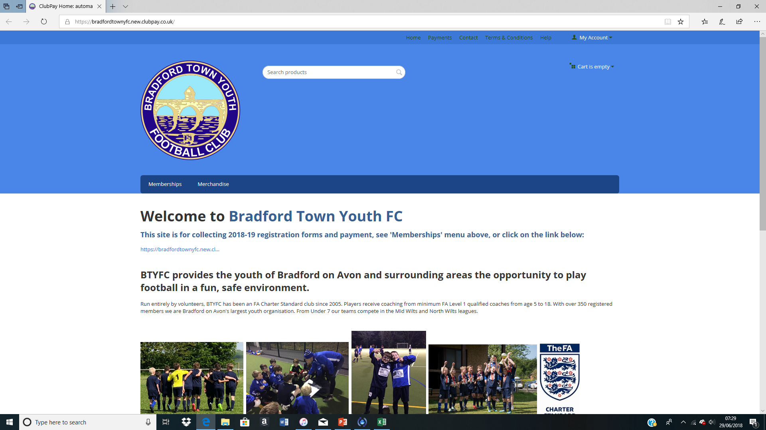
BTYFC registration process has been simplified
__________________________________________
ClubPay:
Lower Admin
Greater Financial Control
Transparency/Auditable
Data collection/availability
GDPR compliant
User friendly
ClubPay has been fully tested on Under 13s Mustangs. Feedback was positive:
“It was pretty easy, even for this technophobe”

Slide 3
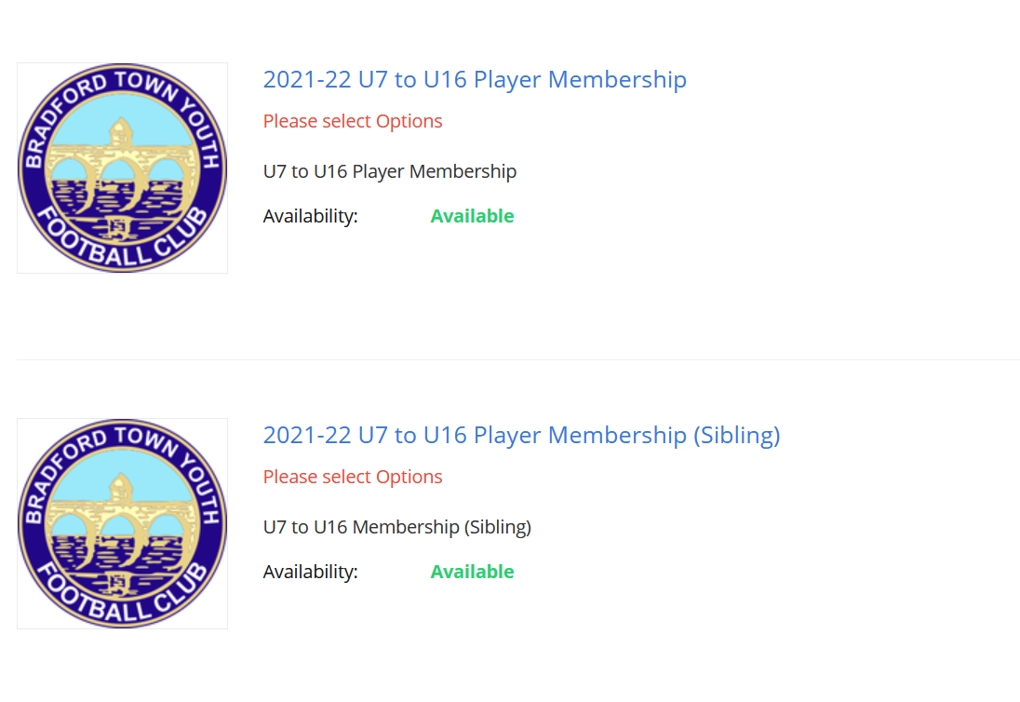
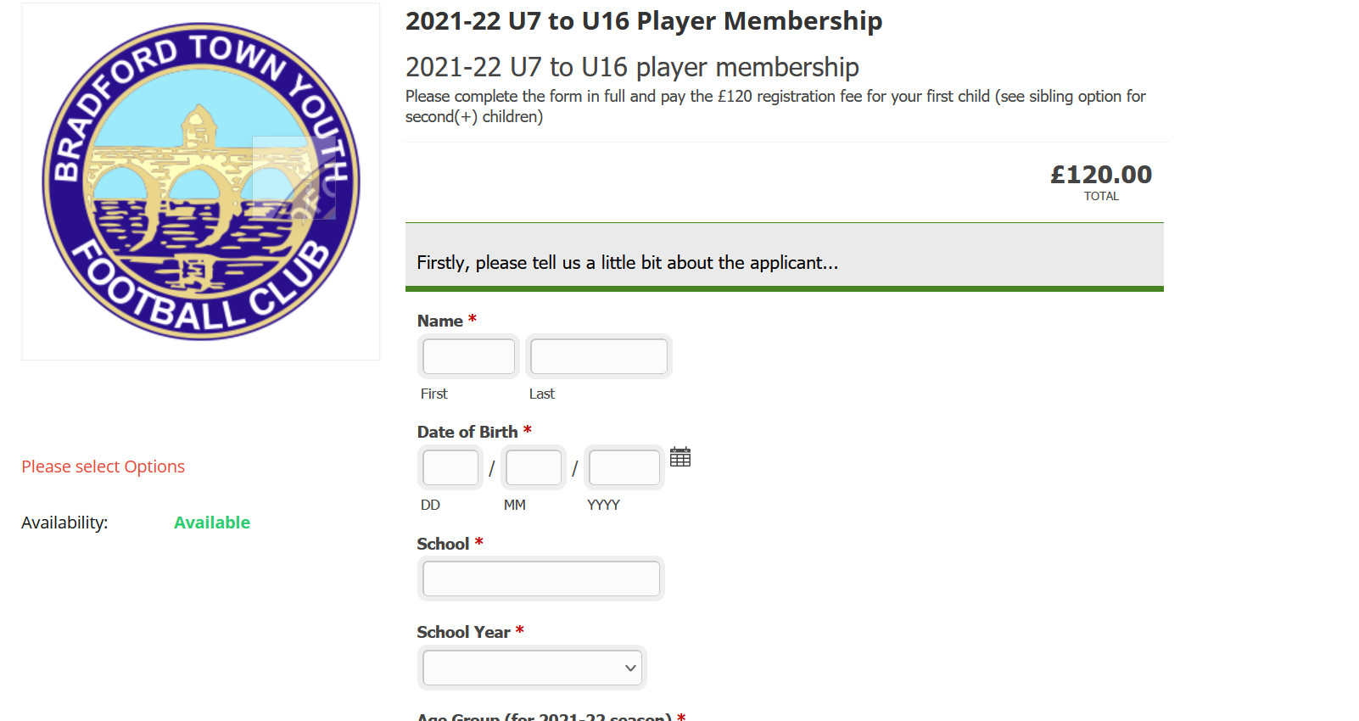
ClubPay: How does it work?
__________________________________________
Select 1 of 2 products
(see slide 5)
Select ‘Memberships’ tab
Complete details

Slide 4
ClubPay: Product options
__________________________________________
Fees cover:
Facilities
Kit/Equipment
League registration fees
FA Coaching courses/DBS checks
Insurance
Please select the correct option for your player:
2021-22 U7 to U16 player membership: the majority of players will fall in to this category
2021-22 U7 to U18 player membership (sibling): use this for your second(+) children

Slide 5
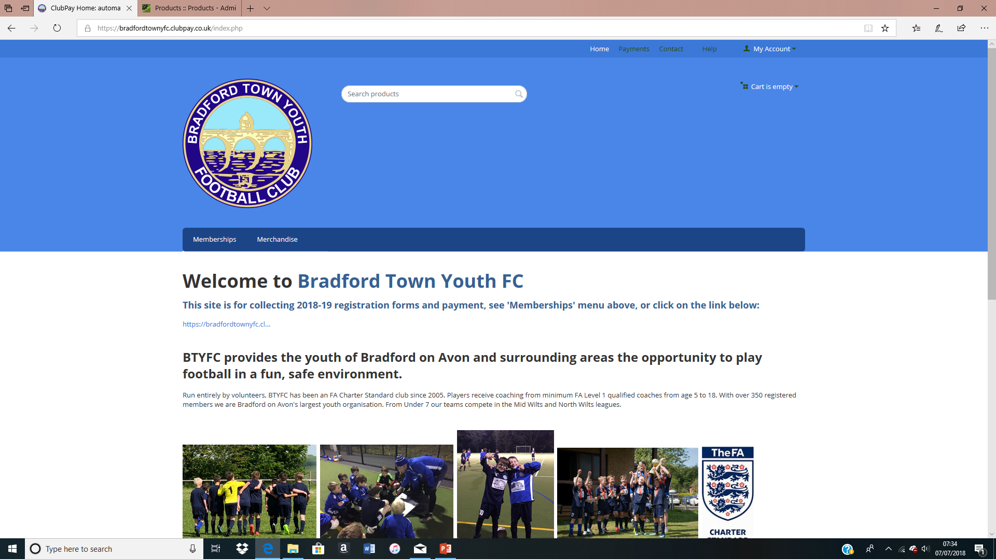
ClubPay: Help!
__________________________________________
Please contact your Coach/Manager in the first instance for ClubPay support.
Otherwise, please use the ‘Contact’ option on the Homepage.

